Slide 1
literary tea pots
Created by Mrs. Peachee

Slide 2
Slab construction
You will explore the techniques used in slab construction.
You will demonstrate mastery slab rolling
You will demonstrate a clear understanding of how to manage the moisture of your slabs.
You will pre-plan by creating a sketch and template for your teapot
You express your concepts of a given piece of literature. (any age level)
You will create a miniature plaque to accompany your piece explaining your interpretation.

Slide 3
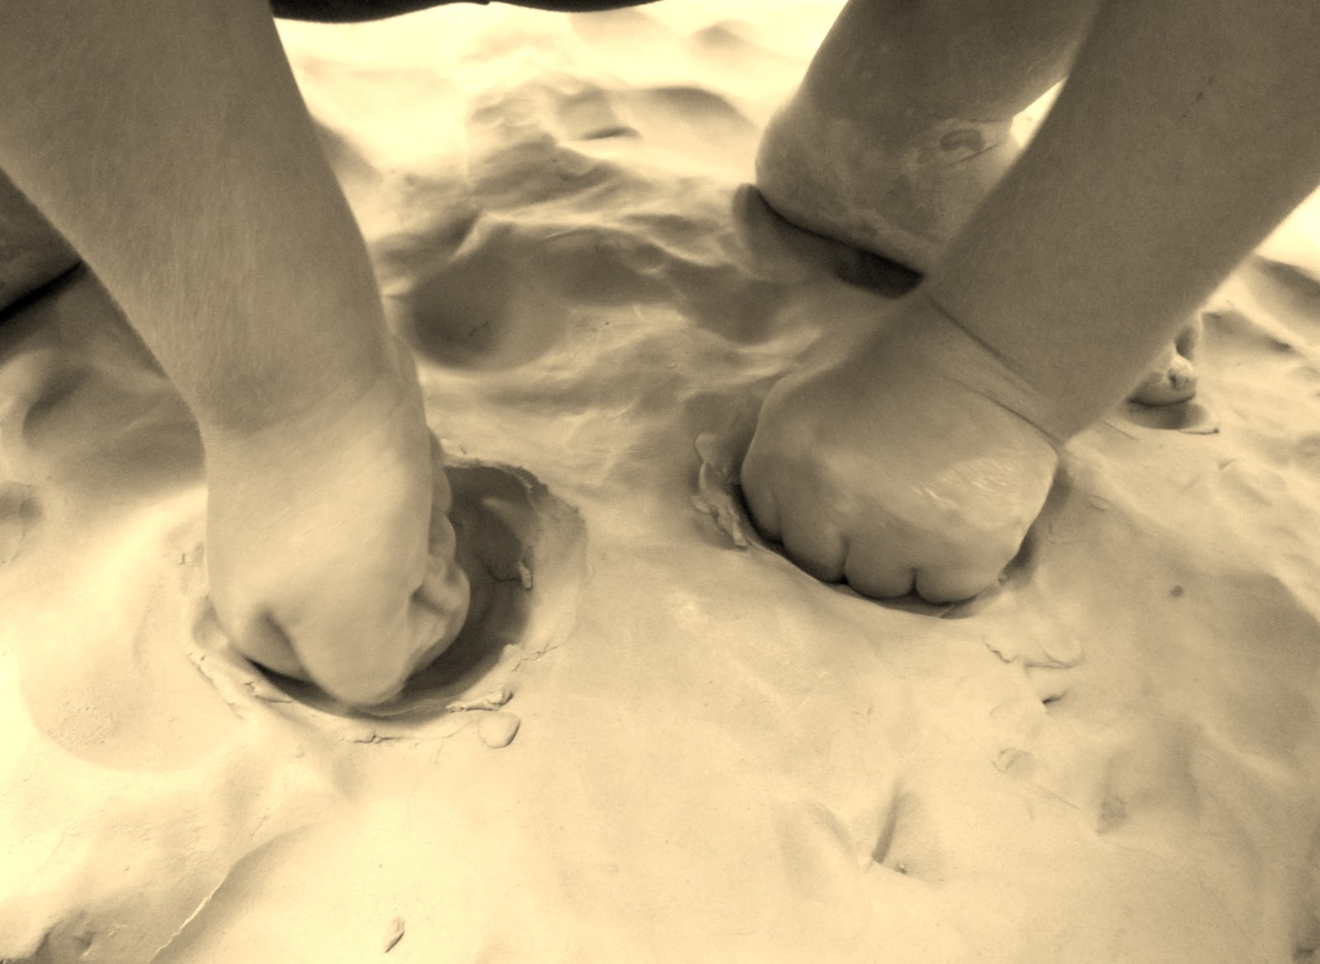
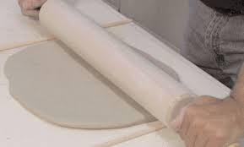
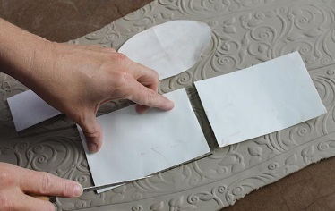
Rolling a slab
pound it out!
Roll it out!
Cut it out!
-Wedged clay can by pounded into a basic shape prior to rolling.
Remember your guide sticks and moist fabric!
Use paper templates to get your basic shape…..instruction coming ☺

Slide 4
Making a template:
2 – 4x4 Squares for the two sides of your teapot
1- oval shape to fit the base of your teapot
1 smaller rectangle for the spout.
CUT YOUR PIECES OUT WITH PAPER TO ASSURE EQUAL SIZE BEFORE CUTTING THEM OUT OF CLAY.

Slide 5
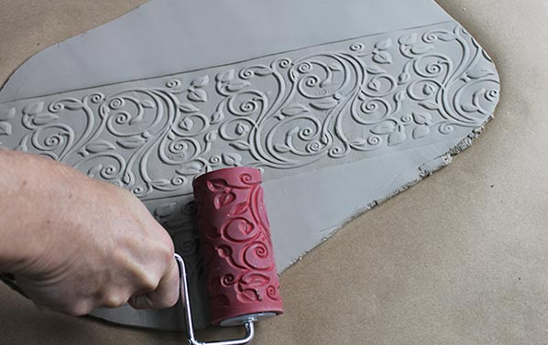
What is texture?
How does texture add visual appeal to a piece?

Slide 6
Techniques
Apply overall texture prior to cutting out templates from slab.
mat
scratching
applications
Texture mats are available as well as any surface with a texture.
**Create texture before cutting out**
Carving/ Subtractive
Various clay tools are available to use.
**Typically applied after construction
Coils & sprigs
**Added after piece is constructed**

Slide 7
Construction
Attach 2 sides
Place on Base
Attach

Slide 8
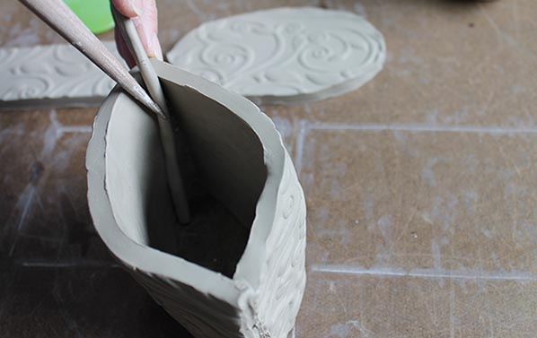
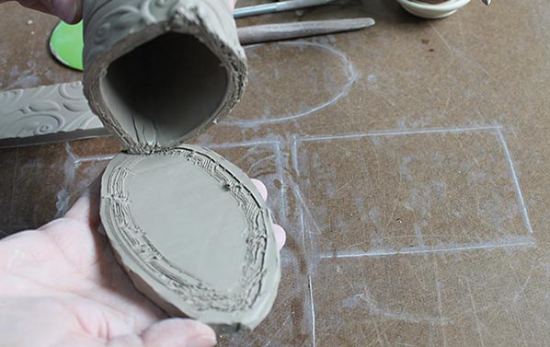
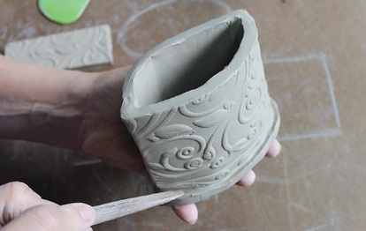
Putting it all together

Slide 9
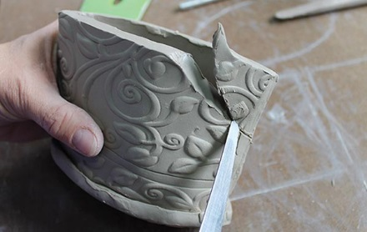
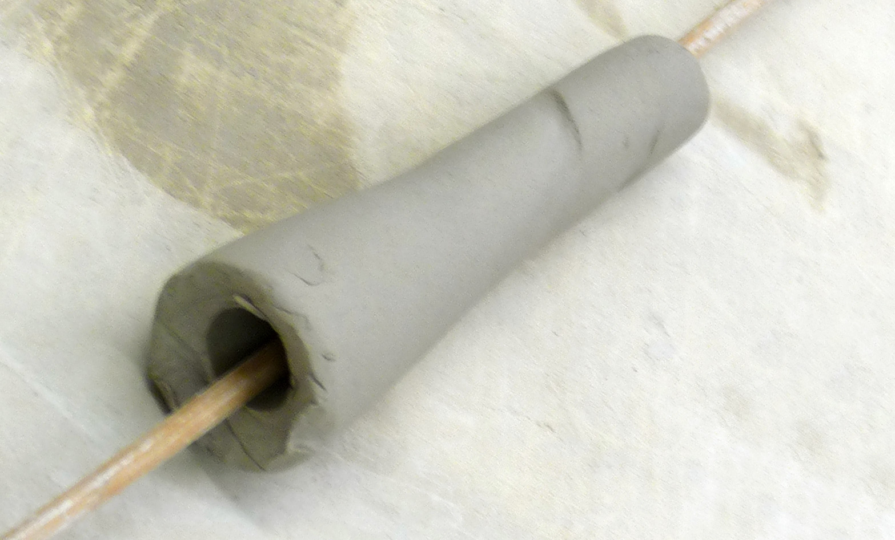
Spouts
Traditional Spout for a Teapot.
-Coil that has graduated thickness
-insert dowel rod down the center.
**Or wrap slab around a dowel rod**
- When it is near leather hard it is ready to attach.

Slide 10
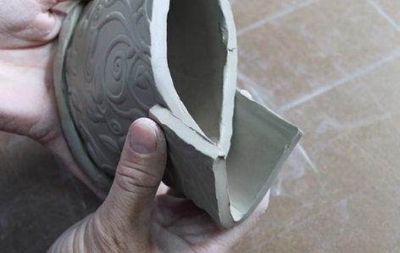
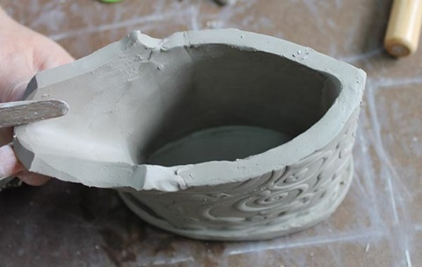
Attaching a Spout
Best fit
Remove excess
Attach and design

Slide 11
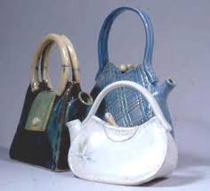
Mixing it up!
Requires four side pieces and a different shaped spout.

Slide 12
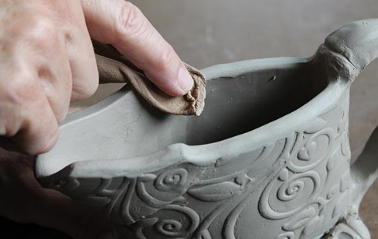
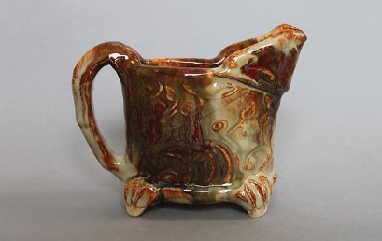

Slide 13
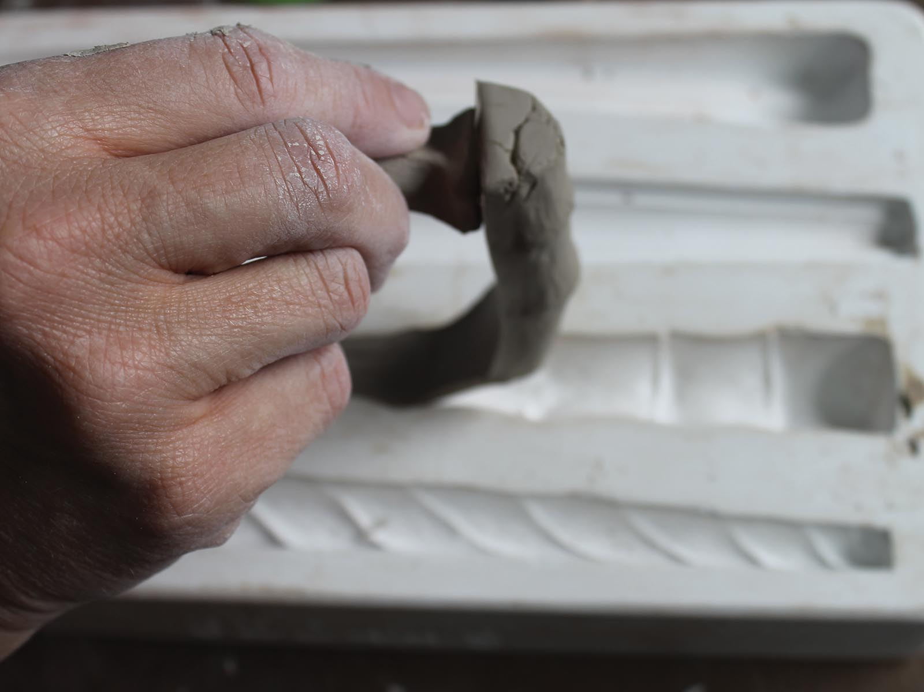
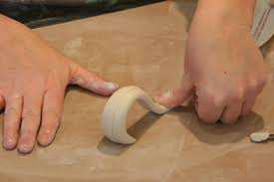
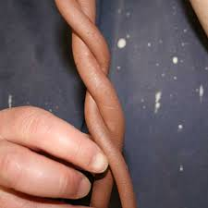
Handles
Slab built handles
Coil built handles
Press mold handles
**Will have to plan ahead to make these!**

Slide 14
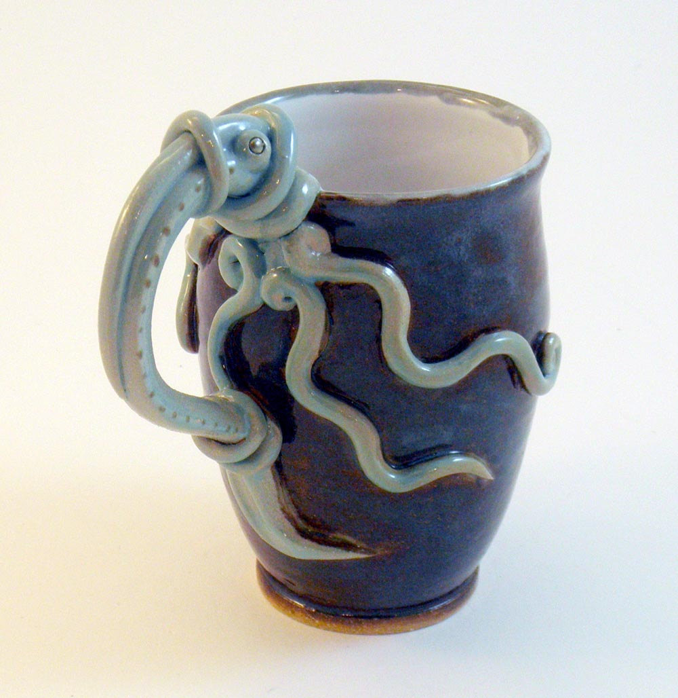
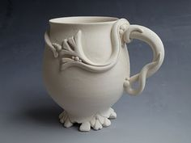
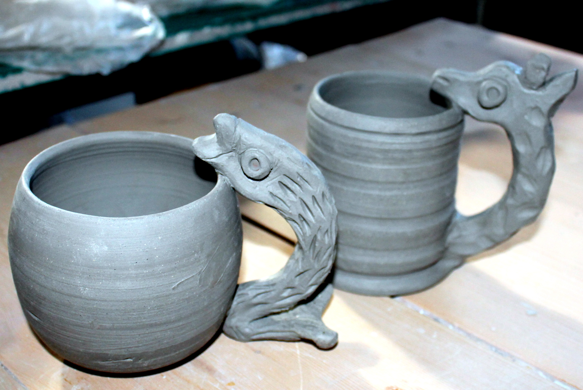
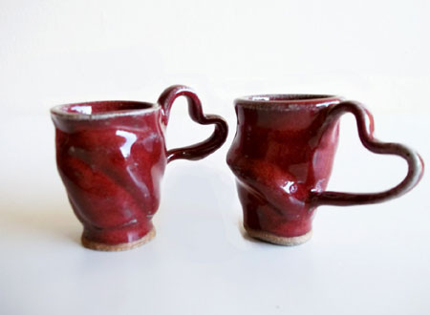
Creative handles
Many of these image are obviously not teapots….but AWSOME HANDLES! ☺

Slide 15
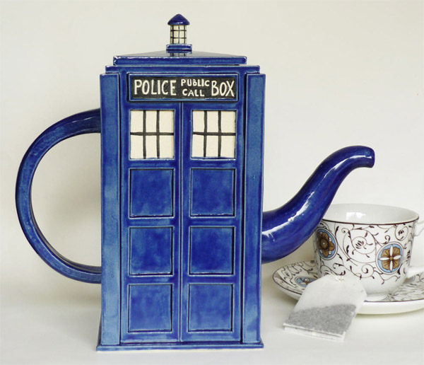
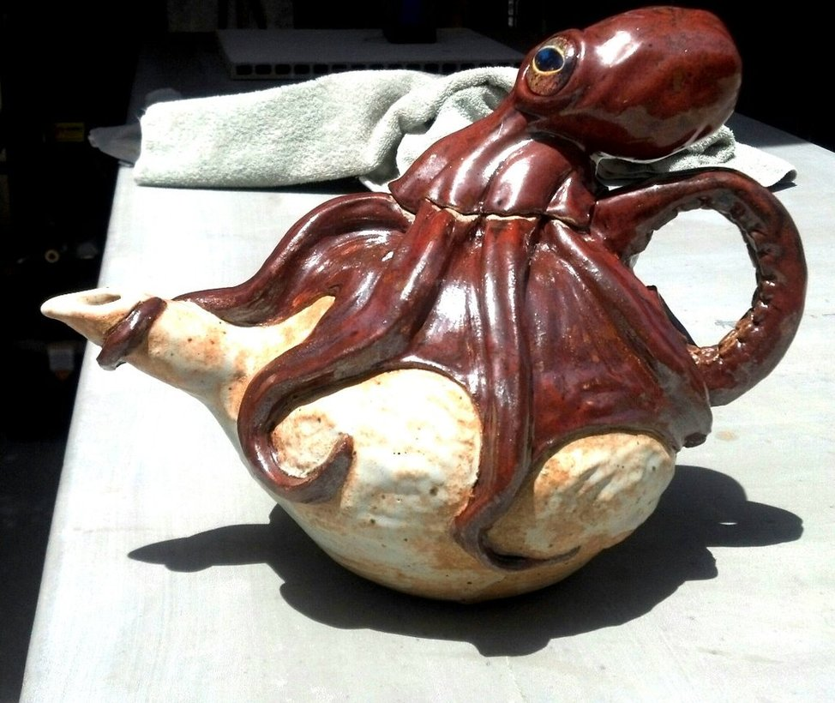
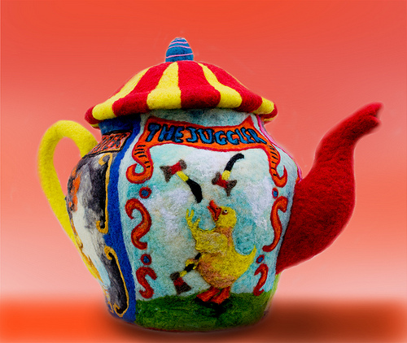
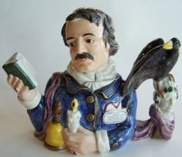
Literary Influences:

Slide 16
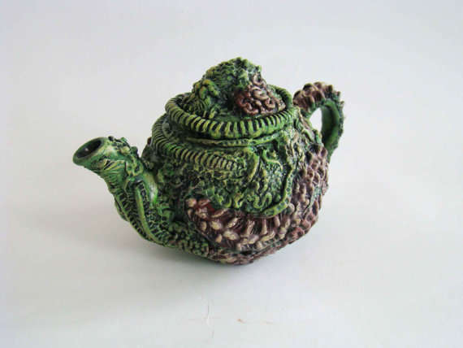

Slide 17
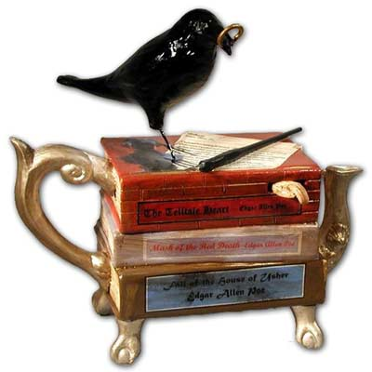

Slide 18
Time to get started
Select a favorite song, book, children’s story, folktale, movie, etc…
Brainstorm
Sketch your ideas
(You should have several ideas!!!)
Begin Mapping out the steps needed
See me for tips and suggestions
Begin Working!!!

