Slide 1
Meet the Anasazi People
Click on the Kokopelli to begin your journey. Listen for details about who the Anasazi people were.
Where did they live?
When did they live?
What made their homes unique?
What happened to the people of that culture?

Slide 2
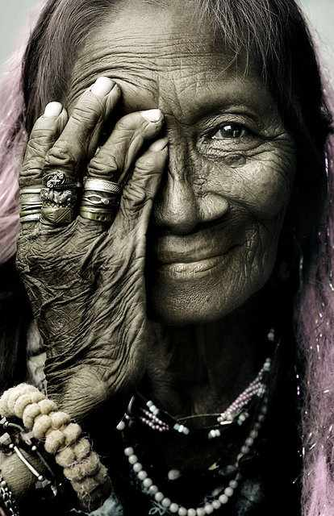
Who were the Anasazi?
Their tribes evolved from nomadic to sedentary
They are the ancestors of the modern- day Pueblo Indians.

Slide 3
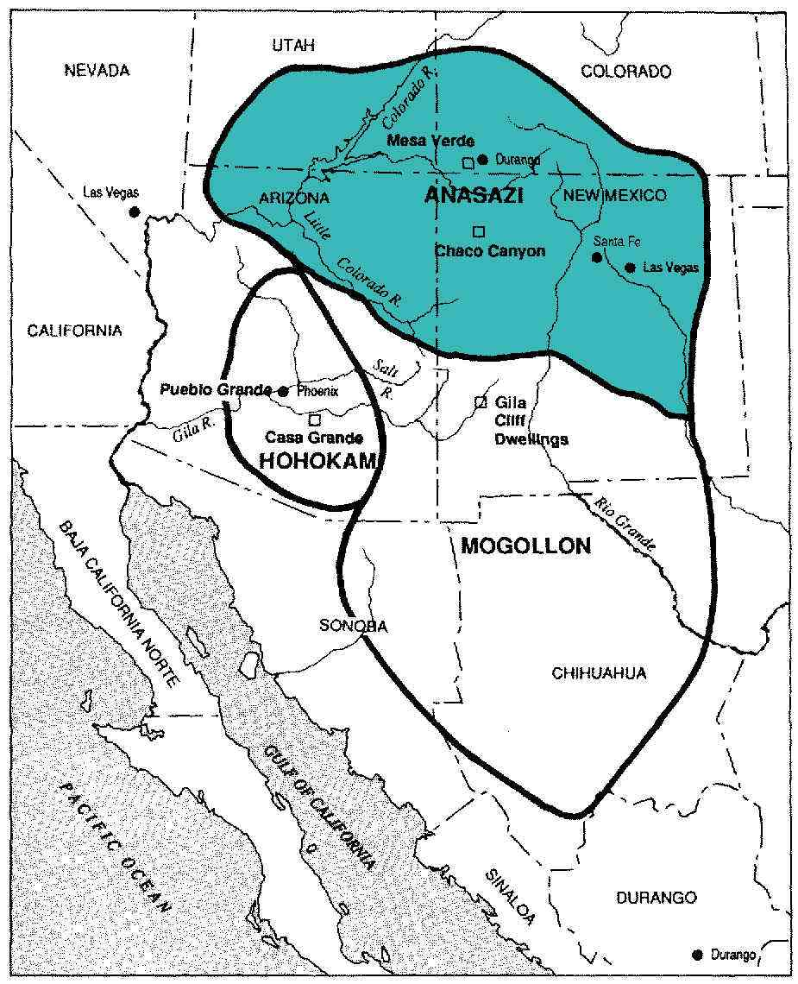
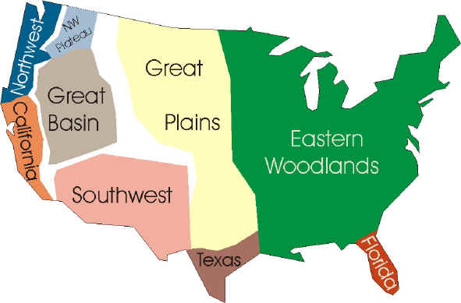
Location of the Anasazi
They lived in an area called the FOUR CORNERS where the states of Arizona, Utah, New Mexico and Colorado come together.

Slide 4
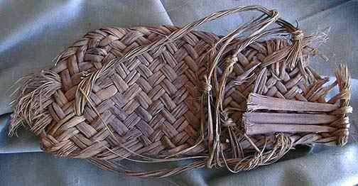
Anasazi history
Archaeologists identified the Anasazi culture through artifacts found in the ancient dwellings
The earliest traces of the Anasazi were discovered to be from year 1 A.D. to 1300 A.D

Slide 5
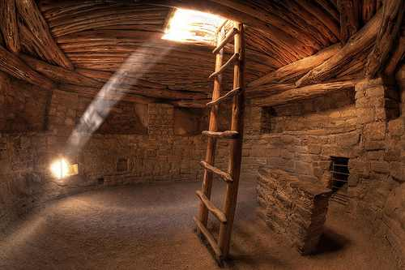
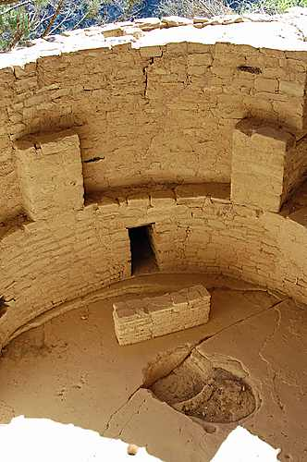
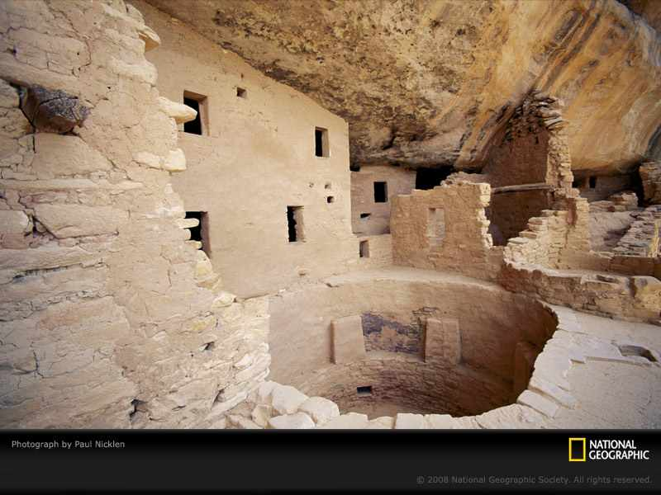
Anasazi Villages
The Anasazi created what Archeologists refer to as “Kivas”.
Kivas are communal, above ground buildings that belonged to an individual families or entire clans
Used for Religious Ceremonies

Slide 6
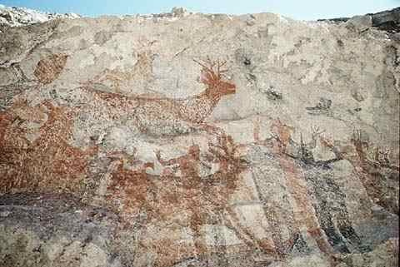
Pictographs
Pictures of
Sun/Moon
Animals
Hunting

Slide 7
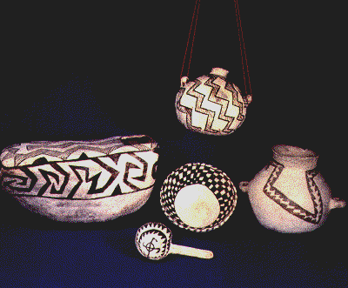
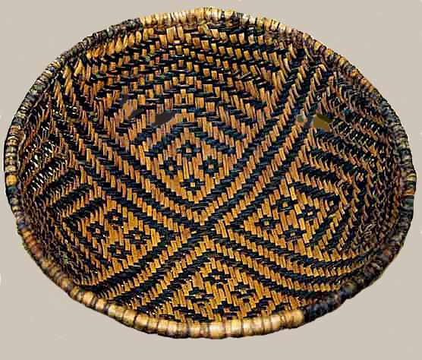
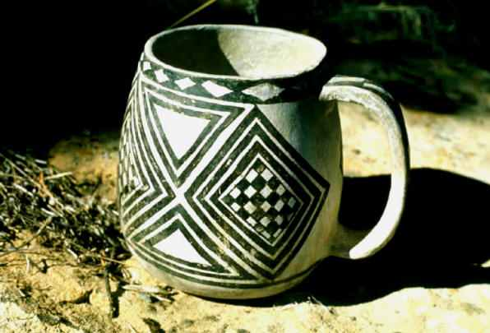
Anasazi Pottery
Archeologists found SHARDS (pieces) of pottery while digging in Mesa Verde

Slide 8
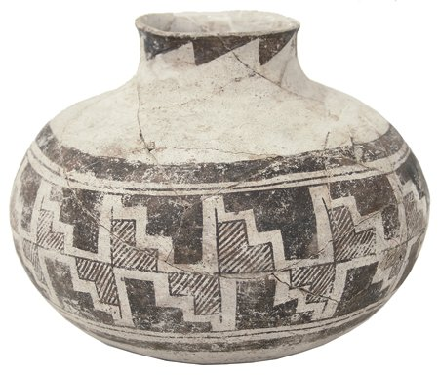
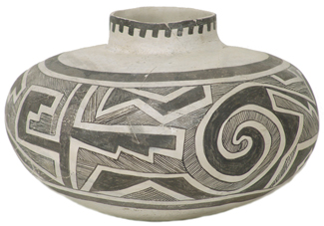
Anasazi Designs
Pottery was made by women.
Designs were passed down from mother to daughter.

Slide 9
Southwest Indian Pottery
Pueblo communities of the American Southwest created regional pottery styles over time as individual potters integrated traditions from the past with their own innovations. There are four important pueblo styles & potters noted in this presentation:
Acoma-Lucy Lewis, San Ildefonso-Maria Martinez, Hopi-Nampeyo, & Santa Clara-
Sara Fina Tafoya.

Slide 10
Lucy Lewis – Acoma Pueblo (1897-1992)

Slide 11
The Acoma settlement of "Sky City" is the oldest continuously-inhabited city in the U.S.

Slide 12
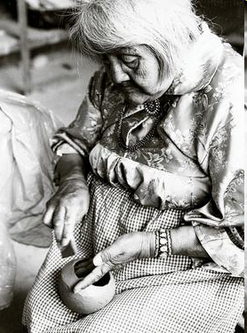
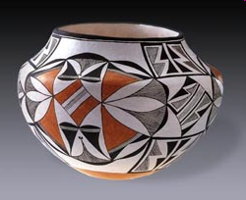
Lucy Lewis is regarded as the matriarch of Acoma pottery
She started making pottery at the turn of the 20th century, continuing a tradition dating back hundreds of years.
Lucy dug & prepared her own clay & used the coil technique.
Lucy got inspiration for her designs -- painted on with colored slips -- from shards found in the sacred Kivas of the pueblo & Anasazi and Mimbres pottery she studied in the Museum of New Mexico.
Her work has been shown nationally and internationally.

Slide 13
Ancient examples of traditional Acoma pottery. It can take up to 80 hours to make a piece.

Slide 14
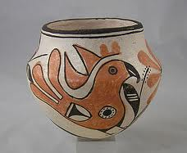
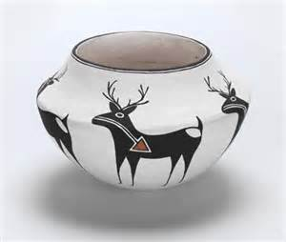
Lucy Lewis was one of Acoma's greatest innovators……
She nevertheless always adhered to traditional Acoma materials and methods of pottery making.
In the 1950s, Lucy began to incorporate Mimbres designs of the past to help develop her own unique expression.
Here she replicates the heartline deer characteristic of the Zuni Pueblo.

Slide 15
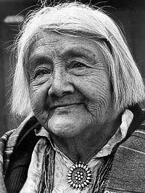
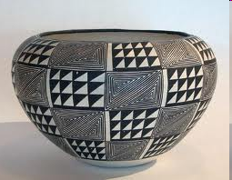
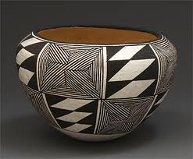
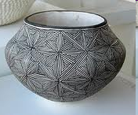
Lucy Lewis
She ultimately became known for her "star-burst" pattern, which consisted of fine black lines on a white background created by using the needle-point of the yucca plant as a paint brush.

Slide 16
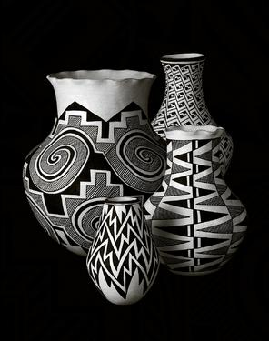
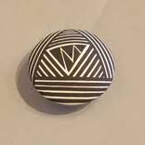
Many of Lucy Lewis’ pots look very modern in their design
Lightning Seed Jar
Acoma pottery is distinctive for its complexity and craftsmanship

Slide 17
San Ildefonso Pueblo Maria Martinez’ Home 1887-1980

Slide 18
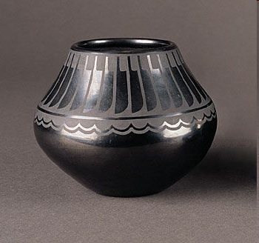
Maria Martinez
As Maria and Juln developed
Maria examined traditional San Ildefonso Pueblo pottery styles & techniques to create pieces which reflect her people’s legacy of fine artwork & crafts.

Slide 19
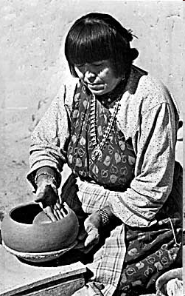
Steps in making a pot:
Digging & preparing the clay
Forming a pot, using a “ pukis” (supporting mold) where a round bottom of a new piece may be formed, creating the base of the pot
Scraping with a gourd rib in criss-crossing motions to smooth out the wall of the pot
Sanding the dried pot to remove surface irregularities
Applying iron-bearing slip & burnishing it to a high sheen with a smooth river stone
Decorating the pot with another slip
Firing the pot

Slide 20
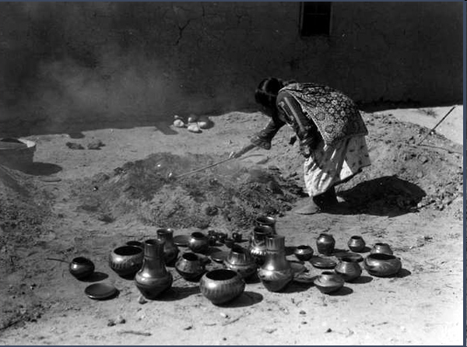
The Firing Process
When the fire has reached its maximum heat it is smothered with ash or fresh manure, producing a smoke-filled oxygen-reducing atmosphere that turns the pots black.
Variations in the process can produce pottery with black areas and red areas, which are also popular.

Slide 21
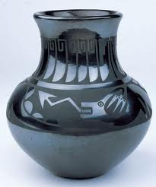
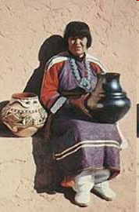
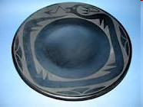
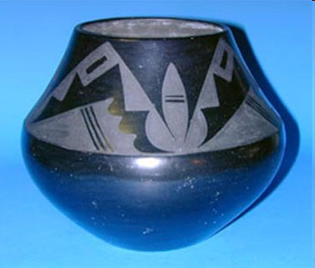
Maria Martinez
As Maria & husband Julian developed their new Black on Black Style-- & as the building of the railroad advanced with more people vacationing-- San Ildefonso Pueblo pottery craft exploded in popularity & in sales.

Slide 22
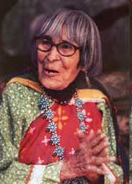
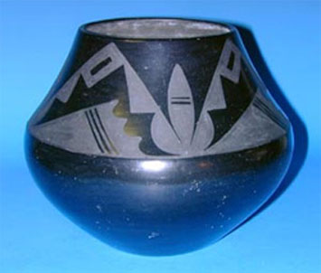
Maria’s Accomplishments
The true legend behind Blackware Pottery is Maria Martinez herself. Maria won many awards and presented her pottery at many World Fairs.
She received the initial grant from the National Endowment for the Arts to fund a Martinez pottery workshop in 1973.
Maria passed on her knowledge and skill to many others including her family, women in the pueblo, & students.

Slide 23
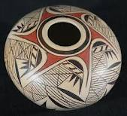
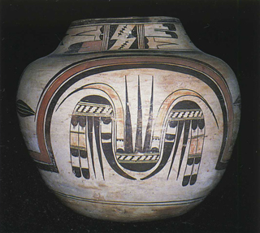
Nampeyo
1856-1942
Nampeyo is given credit for starting the revival of Hopi pottery, the so-called "Sikyatki Revival”, influenced by designs from not only prehistoric & historic Hopi, but by cultures other than Hopi. In a sense, she revived Hopi pottery; but since her work differs greatly from that of the Sikyatki periods, she is credited with the birth of contemporary Hopi pottery, now called Hano Polychrome. Without Nampeyo, Hopi pottery may have been only an art form of the past.
Her descendants continue the legacy of Nampeyo
by adapting her designs to their own work and interpretations.

Slide 24
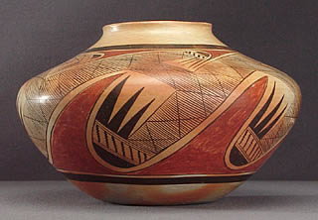
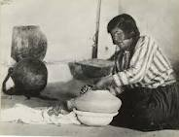
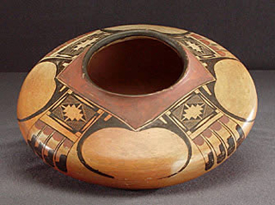
Three designs that they claim to belong to the Corn Clan are:
the Eagle Feathers design,
the Migration Design and
the Spider Design.

Slide 25
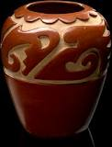
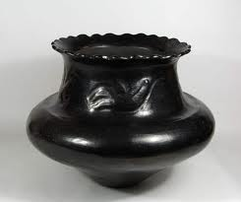
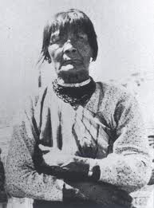
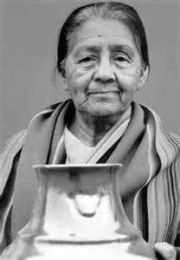
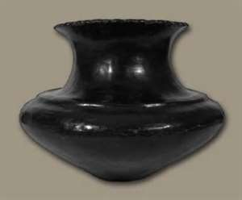
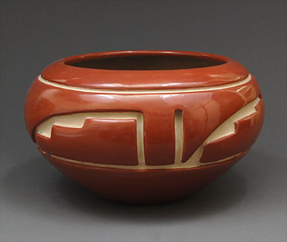
Sara Fina Tafoya
Sara was the leading potter in Santa Clara, master of large and small utilitarian forms, mainly in black. Some of her storage ollas were 30 inches in their largest dimension. She & her daughter Margaret began to incise (carve) designs into their pots. This is the innovation that they are known for. 1904-2001
Sara Fina Tafoya
Margaret Tafoya

Slide 26
Quiz Click on Sun:
Notes:
Link to slide 7

